Slide 1

Quick Bite Canteen:
Presented by:
Jayanth JH (E0422009)
Yakash S(E0422008)
Roshini Priya V (E0422053)

Slide 2
Introduction and Motivation
Quick Bite Canteen aims to transform the campus dining experience. Our motivation stems from the need to provide students and faculty with a seamless, efficient, and personalized food ordering system. We believe in leveraging technology to enhance convenience and satisfaction.
1
Quick & Easy Ordering
Streamlined process for students and faculty to order food effortlessly.
2
Customized Meals
Tailored food options catering to diverse dietary needs and preferences.
3
Live Order Tracking
Real-time updates on order status, reducing uncertainty and wait times.
4
Campus-wide Delivery
Efficient food delivery across campus, integrated with GPS for precision.
5
User Feedback System
Mechanism for users to provide ratings and feedback for continuous service improvement.
6
Eco-Friendly Features
Initiatives to reduce food waste and promote sustainable practices within the canteen.

Slide 3
Addressing Key Challenges
Current campus dining facilities face several challenges that impact efficiency and user satisfaction. Quick Bite Canteen aims to directly address these pain points with a modern, integrated solution.
Long queues and waiting times: Leading to frustration and lost productivity during peak hours.
Poor communication: Gaps between canteen staff and users result in misunderstandings and inefficiencies.
No order tracking: Users are left in the dark about their food's status, causing anxiety and delays.
Manual processes: Prone to errors, slowing down operations and increasing workload for staff.
Limited meal customization: Inadequate options for specific dietary needs, allergies, or preferences.
Lack of user feedback: Hinders continuous improvement and adaptation to user preferences.

Slide 4
Proposed Solution & Objectives
Quick Bite Canteen's solution focuses on leveraging technology to enhance the entire campus dining experience, ensuring convenience, personalization, and efficiency for all users.
Proposed Solution
Objectives
Campus-Specific App: Develop a food ordering app with real-time tracking and digital payments, tailored for university use.
Reduce Waiting Time: Streamline food delivery and order fulfillment for faster service.
Customization & Preferences: Allow users to personalize meals and specify dietary requirements.
Improve User Satisfaction: Enhance experience through personalization and direct feedback channels.
Canteen Staff Dashboard: Provide a web-based interface for efficient order and inventory management.
Promote Eco-Friendly Practices: Encourage sustainability by minimizing food waste and efficient resource management.

Slide 5
Technology Stack Justification
Our choice of technology ensures a robust, scalable, and user-friendly system, leveraging industry-leading tools for seamless performance and security.
React Native: Cross-Platform Mobile Development
Node.js with MongoDB/Firebase: Scalable Backend
Firebase Auth & Razorpay: Secure Payments & Authentication
Enables building a native mobile app for both iOS and Android from a single codebase, ensuring a smooth UI/UX and real-time capabilities for quick order placement and tracking.
Provides a fast, scalable, and efficient backend. Node.js handles high concurrent requests, while MongoDB (NoSQL) or Firebase (real-time NoSQL) offers flexible data storage and real-time data synchronization for dynamic menu updates and order management.
Firebase Authentication ensures secure user login and management. Razorpay provides seamless, secure digital payment integration, supporting various payment methods for convenient transactions.

Slide 6
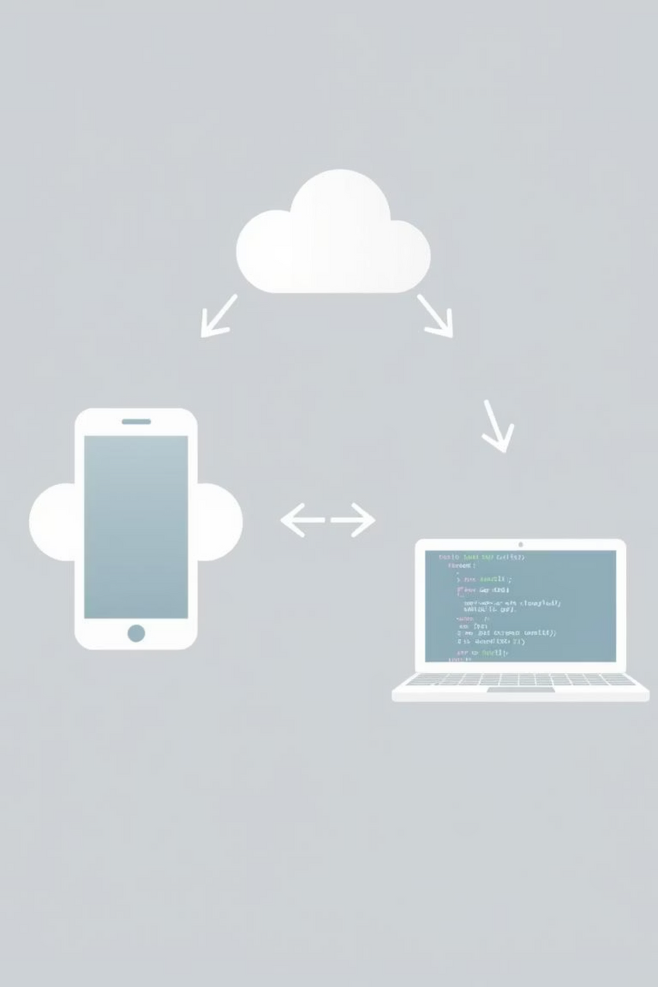




Quick Bite System Architecture
The Quick Bite Canteen system is designed with a multi-layered architecture to ensure robust performance, scalability, and seamless interaction between users, the backend, and canteen staff.
Client Layer
Mobile app (React Native) for students, faculty, and guests. Enables menu browsing, order placement, real-time tracking, and secure payments.
Backend Layer
Node.js server handling API requests, business logic, order management, and authentication, interacting with MongoDB/Firebase for data storage.
Admin/Canteen Layer
Web-based dashboard for canteen staff and administrators to manage orders, inventory, track deliveries, and respond to user queries efficiently.

Slide 7







Modules & Key Features of Quick Bite
User Module
Menu Module
Order & Delivery Module
Manages registration, login, and personalized profile settings, including dietary preferences.
Displays daily menu with customization options and personalized recommendations based on past orders.
Facilitates order placement, real-time tracking, and efficient delivery to specified campus locations.
Payment Module
Admin/Canteen Module
Feedback & Support Module
Ensures secure digital payments and automatic invoice generation for all transactions.
Provides a comprehensive dashboard for staff to manage orders, update inventory, and oversee operations.
Collects user feedback and offers in-app support for queries and issue resolution.
Engagement & Loyalty Module
Sends personalized offers, rewards loyal users, and promotes active engagement within the app.

Slide 8
Expected Outcomes of Quick Bite Canteen
Implementing the Quick Bite Canteen system is projected to bring significant improvements to campus dining, enhancing efficiency, user satisfaction, and sustainability.
1
2
3
Reduced Waiting Time
Enhanced User Experience
Streamlined Operations
Streamlined food ordering and delivery processes will significantly cut down on queues and wait times, improving efficiency during peak hours.
Personalized meal options, real-time order tracking, and a seamless app interface will boost user satisfaction and convenience.
A digital dashboard for canteen staff will automate order management and inventory control, leading to improved operational efficiency.
4
5
Higher User Engagement
Improved Sustainability
Through feedback features, special offers, and loyalty rewards, users will feel more connected and valued, increasing app usage.
The system will help reduce food waste through better prediction and management, promoting eco-friendly practices across campus.

Slide 9
Conclusion and Future Scope
Quick Bite Canteen offers a transformative solution for campus dining, addressing current inefficiencies and laying the groundwork for future innovations.
Conclusion
Future Scope
Quick Bite drastically improves campus dining by reducing wait times and enhancing the overall user experience.
Integrate AI-driven meal recommendations based on user history and dietary trends.
It offers personalized meal options, real-time tracking, and secure digital payment solutions.
Explore smartwatch integration for even faster and more convenient ordering.
Canteen operations become more efficient through a dedicated admin dashboard and robust inventory control.
Expand the system to include other campus cafes and eateries.
Implement advanced eco-tracking features to further promote sustainability and reduce waste.

Slide 10
References
Firebase Documentation – https://firebase.google.com/docs
React Native Documentation – https://reactnative.dev/docs
Node.js Official Docs – https://nodejs.org/en/docs
Razorpay Integration Guide – https://razorpay.com/docs/
MongoDB Documentation – https://www.mongodb.com/docs/
UI/UX inspiration from Food Delivery Apps like Zomato and Swiggy

